Slide 1

UNIT 4
BACKTRACKING
Branch-And-Bound
(Reference Book - Horowithz Sahni)
Notes:
1
1

Slide 2
2
Basic Concepts
Live Node
A node which has been generated and all of whose children have not yet been generated is called a live node.
E-node
The live node whose children are currently being generated is called the E-node.
Dead Node
A generated node which is not to be expanded further or all of whose children have been generated is called a dead node.
Bounding function
It is used to kill live nodes without generating all their children.
Notes:
2

Slide 3
3
Branch – bound
Notes:
3
3

Slide 4
4
Outline
The method
Control abstractions
Least Cost Search (LC Search)
Bounding
FIFO branch and bound
LC branch and bound
0/1 Knapsack problem
LC branch and bound
FIFO branch and bound solution
Traveling sales person problem
Notes:
4

Slide 5
5
Branch and Bound
In backtracking, we used depth-first search with pruning to traverse the (virtual) state space. We can achieve better performance for many problems using a breadth-first search with pruning. This approach is known as branch-and-bound
Branch and Bound is a general search method.
Starting by considering the root problem (the original problem with the complete feasible region), the lower bounding and upper-bounding procedures are applied to the root problem.
If the bounds match, then an optimal solution has been found and the procedure terminates.
Notes:
5

Slide 6
6
Continued…
Otherwise, the feasible region is divided into two or more regions, these sub-problems partition the feasible region.
The algorithm is applied recursively to the sub-problems. If an optimal solution is found to a sub problem, it is a feasible solution to the full problem, but not necessarily globally optimal.
Notes:
6

Slide 7
7
Continued…
If the lower bound for a node exceeds the best known feasible solution, no globally optimal solution can exist in the subspace of the feasible region represented by the node. Therefore, the node can be removed from consideration.
The search proceeds until all nodes have been solved or pruned, or until some specified threshold is met between the best solution found and the lower bounds on all unsolved sub-problems.
Notes:
7

Slide 8
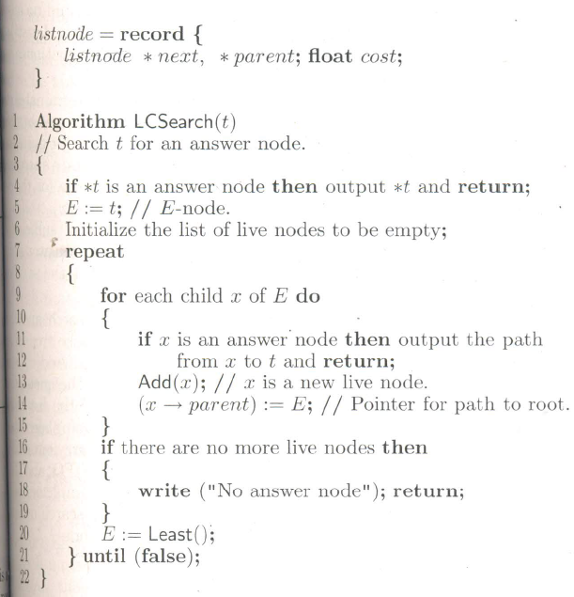
8
Least cost (LC) – search
Notes:
8

Slide 9
9
bounding
Consider that there are n jobs and one processor. Each job i has associated with it a three tuple (p_{i}, d_{i}, t_{i}). Job i requires t_{i} units of processing time. If its processing is not completed by the deadline d_{i}, then a penalty is incurred. The objective is to select a subset J of the n jobs such that all jobs in J can be completed by their deadlines.
The penalty can be incurred only on those jobs not in J.
Notes:
9

Slide 10
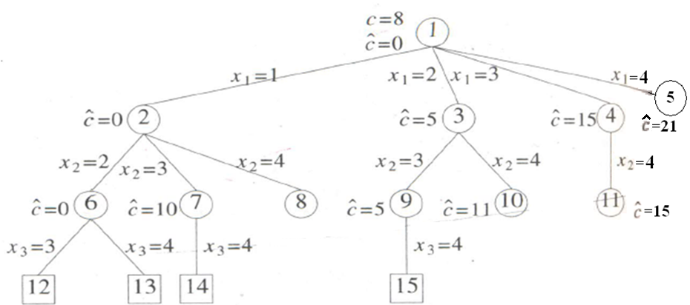
10
example
n = 4 (p₁, d₁, t₁) = (5, 1, 1), (p₂, d₂, t₂) = (10, 3, 2), (p₃, d₃, t₃) = (6, 2, 1), (p₄, d₄, t₄) = (3, 1, 1)
State space tree correspond to variable tuple size formulation
Notes:
10

Slide 11
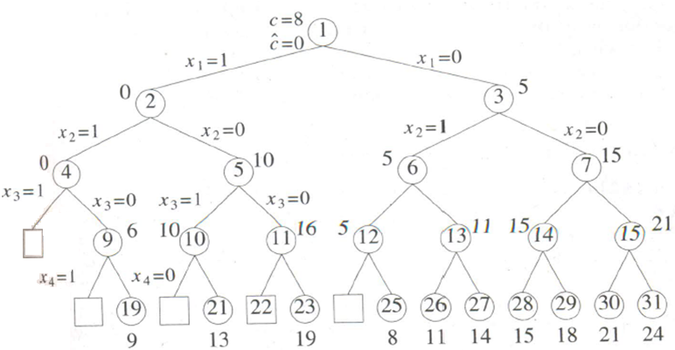
11
Continued…
State space tree correspond to fixed tuple size formulation
Notes:
11

Slide 12
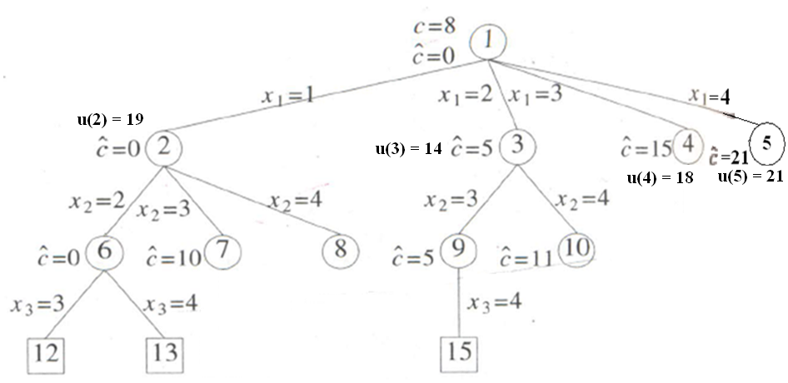
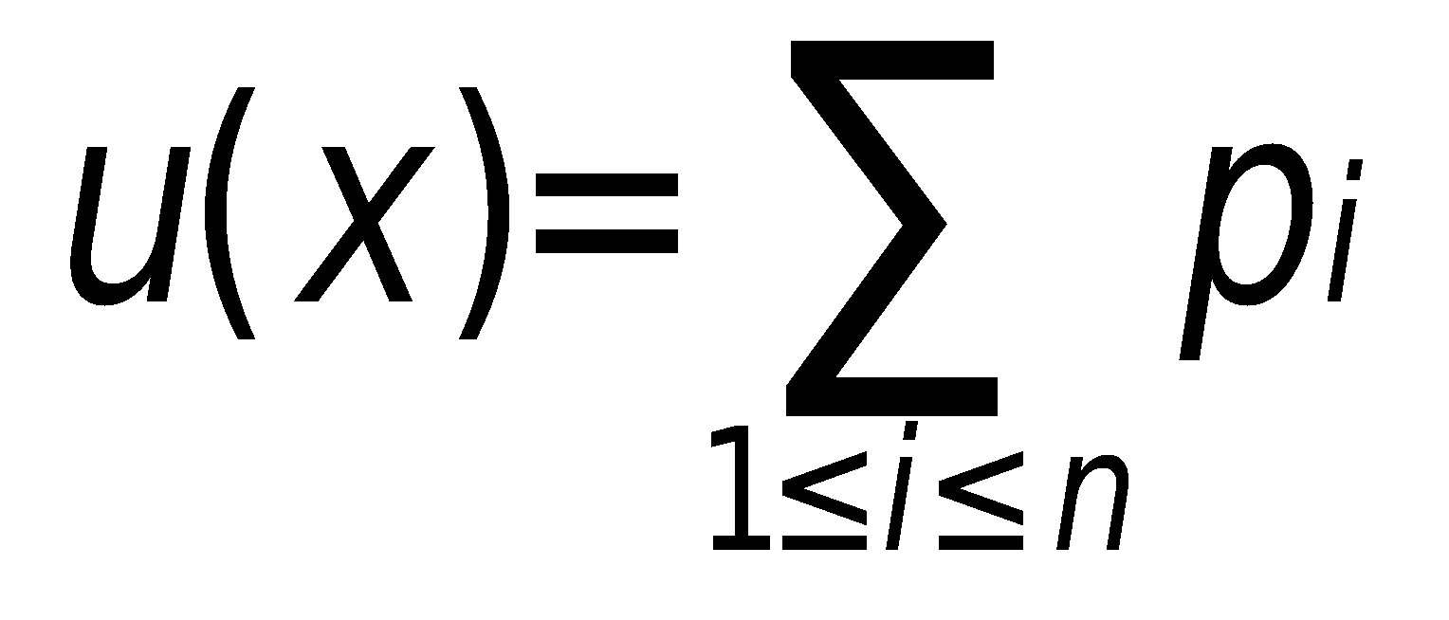
12
FIFO branch and bound
u(6) = 9
u(9) = 8
Infeasible node
If Ĉ(x) > upper, kill node x.
Notes:
12

Slide 13
13
LC branch and bound
u(6) = 9
u(9) = 8
Infeasible node
If Ĉ(x) > upper, kill node x.
Infeasible node
Infeasible node
Notes:
13

Slide 14
14
Traveling sales person problem
For a given instance G of TSP, the row (column) is said to be reduced if and only if it contains at least one zero and all remaining entries are non-negative.
The matrix G is reduced if and if only every row and column is reduced.
∞ | 20 | 30 | 10 | 11
15 | ∞ | 16 | 4 | 2
3 | 5 | ∞ | 2 | 4
19 | 6 | 18 | ∞ | 3
16 | 4 | 7 | 16 | ∞
∞ | 10 | 17 | 0 | 1
12 | ∞ | 11 | 2 | 0
0 | 3 | ∞ | 0 | 2
15 | 3 | 12 | ∞ | 0
11 | 0 | 0 | 12 | ∞
a) Cost Matrix
b) Reduced cost matrix L = 25 u = ∞
Notes:
14

Slide 15
15
Continued…
The total amount subtracted from all the rows and columns is a lower bound on the length of minimum cost tour and may be used as C` value for the root of the state space tree.
Let A be the reduced cost matrix for node R, Let S be a child of R and an edge <i, j> is added to S.
Notes:
15

Slide 16
16
Continued…
If S in not a leaf node, then the reduced cost matrix for S may be obtained as
Change all entries in row i and column j of A to ∞
Set A(j,1) to ∞
Reduce all rows and columns in the resulting matrix except for rows and columns containing only ∞
If r is the total amount subtracted in step 3 then c`(S) = C`(R)+A(i,j)+r
For upper bound function u, u(R) = ∞ for all nodes R.
Notes:
16

Slide 17
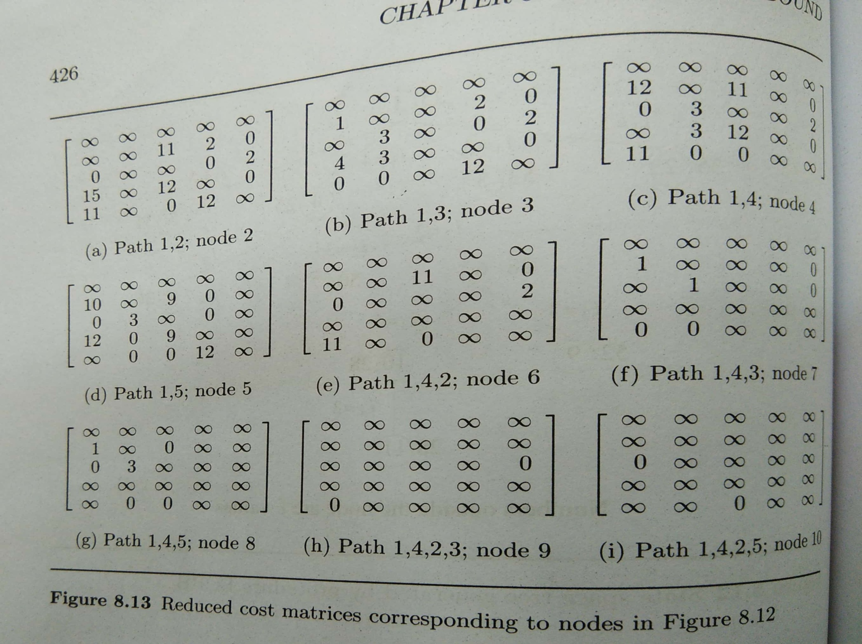
17
Notes:
17

Slide 18
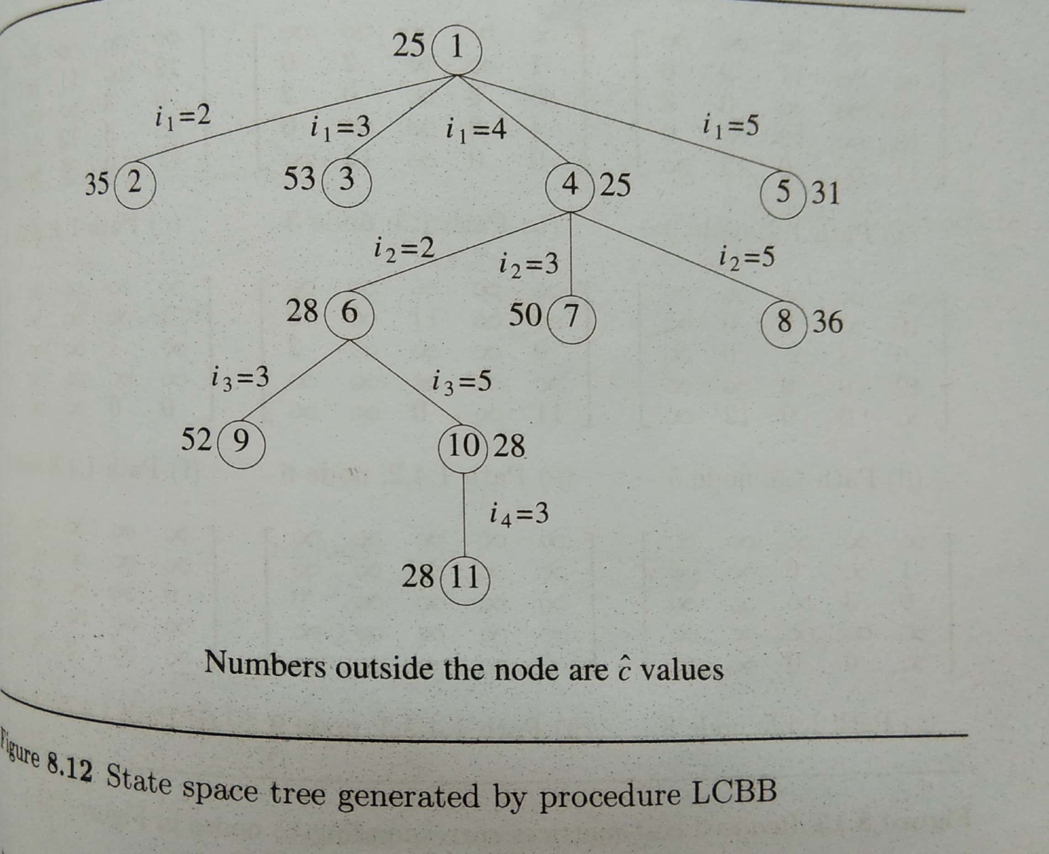
18
Notes:
18

Slide 19
0/1 KNAPSACK PROBLEM
To use the branch-and-bound technique to solve any problem, it is first necessary to conceive of a state space tree for the problem.
two possible state space tree organizations for the knapsack problem.
Still, we cannot directly apply the techniques of FIFO BB and LC Search since these were discussed with respect to minimization problems whereas the knapsack problem is a maximization problem.

Slide 20
0/1 KNAPSACK PROBLEM
This difficulty is easily overcome by replacing the objective function
Σ P_{i} x_{i} by the function - Σ P_{i} x_{i} Clearly, Σ P_{i} x_{i} is maximized iff - Σ P_{i} x_{i} is minimized.

Slide 21
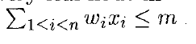
We continue the discussion assuming a fixed tuple size formulation for the solution space.
The discussion is easily extended to the variable tuple size formulation.
Every leaf node in the state space tree representing an assignment for which
is an answer (or solution) node.
All other leaf nodes are infeasible.

Slide 22
For a minimum-cost answer node to correspond to any optimal solution, we need to define c(x) as for every answer node x.
The cost c(x) = ∞ for infeasible leaf nodes.
For non-leaf nodes c(x) is recursively defined to be
min {c ( lchild (x) ),c ( rchild (x) )}.

Slide 23
23
Ubound function for knapsack problem
Algorithm Ubound(cp, cw, k, m)
{
b = cp; c = cw;
for i = k + 1 to n do
if(c + w[i] ≤ m) then
{
c = c + w[i];
b = b – p[i];
}
return b;
}
Notes:
23

Slide 24
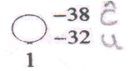
24
0/1 Knapsack problem
Example: n = 4, (p₁, p₂, p₃, p₄) = (10, 10, 12, 18), (w₁, w₂, w₃, w₄) = (2, 4, 6, 9) and m = 15
Ĉ(1) = -[10 + 10 + 12 + 18 *(3/9)] = -38
u(1) = -10 –10 –12 = -32
Notes:
24

Slide 25
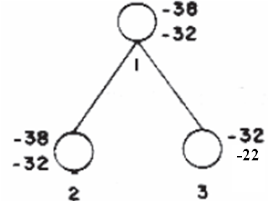
25
Continued…
Ĉ(2) = [-10] + [ - 10 – 12 - 18 *(3/9)] = -38
u(2) = [-10] + [-10 -12 ] = -32
Ĉ(3) = -0 –[10 + 12 + 18 *(5/9)] = -32
u(3) = 0 + [-10 –12 ] = -22
(p1, p2, p3, p4) = (10, 10, 12, 18) (w1, w2, w3, w4) = (2, 4, 6, 9)
m = 15
Notes:
25

Slide 26
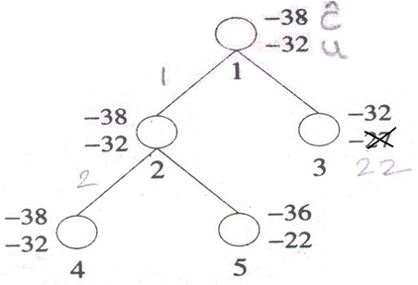
26
Continued…
Ĉ(4) =[ -10 - 10] + [-12 – 18 *(3/9)] = -38
u(4) = [-10 - 10] + (-12) = -32
Ĉ(5) = [-10 - 0] + [-12 - 18 *(7/9)] = -36
u(5) = -10 - 12 = -22
(p1, p2, p3, p4) = (10, 10, 12, 18) (w1, w2, w3, w4) = (2, 4, 6, 9)
m = 15
Notes:
26

Slide 27
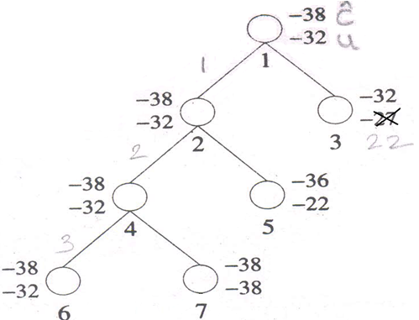
27
Continued…
Ĉ(6) =[ -10 –10 - 12] + [- 18 *(3/9)] = -38
u(6) = [-10 - 10 - 12] + 0 = -32
Ĉ(7) =[ -10 –10] + [-18] = -38
u(7) = [-10 - 10] + [-18] = -38
(p1, p2, p3, p4) = (10, 10, 12, 18) (w1, w2, w3, w4) = (2, 4, 6, 9)
m = 15
Notes:
27

Slide 28
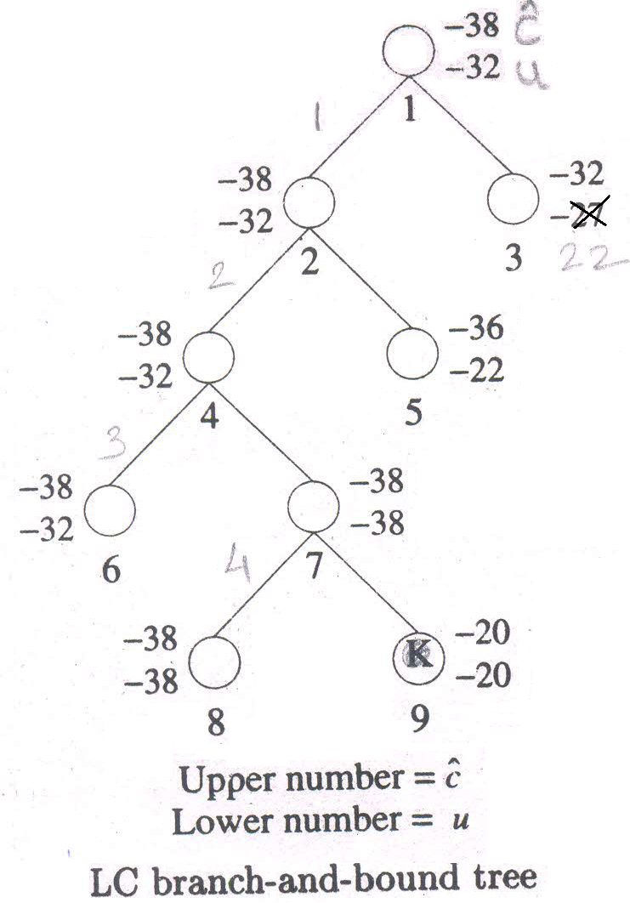
28
LC branch and bound solution
(p1, p2, p3, p4) = (10, 10, 12, 18) (w1, w2, w3, w4) = (2, 4, 6, 9)
m = 15
Notes:
28

Slide 29
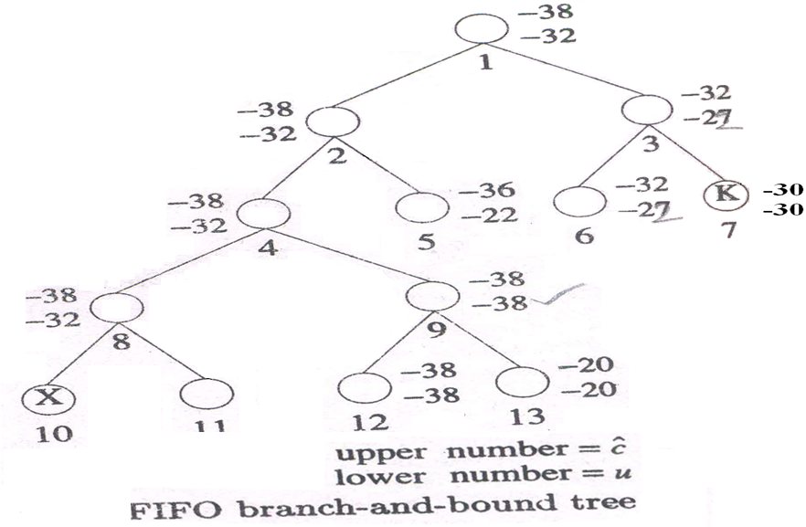
29
FIFO branch and bound solution
(p1, p2, p3, p4) = (10, 10, 12, 18) (w1, w2, w3, w4) = (2, 4, 6, 9)
m = 15
-18
Notes:
29

